Slide 1
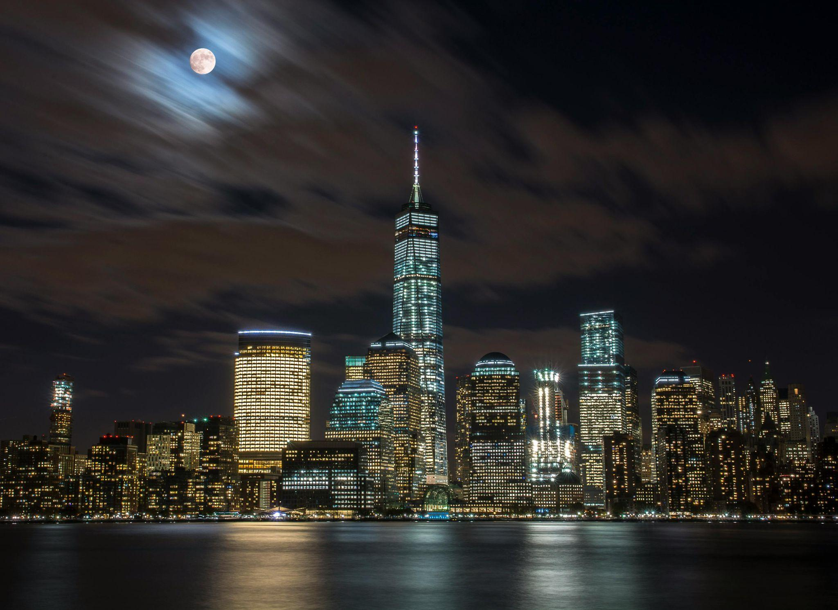
NYC Crime Economical and Social Study - Using Quantitative and Qualitative Approaches
Gopinadh Batchu Dundi Vivek Reddy

Slide 2
Contents
Introduction and Abstract
Literature Review
MVP
HLA
Gantt Chart
References

Slide 3
Introduction And Abstract Urban metropolitans, huge cities like New York City (NYC), face multiple issues that significantly impact public safety, economic well-being, and community welfare. Crime and motor vehicle collisions (MVCs) are some of the problems that occur frequently and have severe consequences. Historically, these incidents have been examined individually, sometimes disregarding potential connections spurred by socioeconomic factors. This literature review synthesizes recent studies in urban crime, MVCs, and socioeconomic determinants—demographic, social, economic, and housing determinants highlighting the potential of an integrated analytical framework for enhancing policy-making and urban management.

Slide 4
Problem Statement
Currently, NYC crime and motor vehicle collisions are predominantly analyzed independently, which results in missing potential interdependencies and underlying socioeconomic influences. Independent processing limits the range of options and dilutes the efficacy of urban policymaking and crime policies. Our project fills this space through an integrated, socio-economically enhanced analysis framework. This approach aims to uncover intersectional patterns and associations between crime incidents and motor vehicle accidents, thus facilitating more effective public safety interventions, optimized resource allocation, and policymaking in New York City.

Slide 5
MVP
Establish standardized preprocessing and normalization for crime, collision, and socio-economic data.
Utilize clustering algorithms (K-means, DBSCAN) to identify overlapping hotspots influenced by socio-economic variables.
Apply preliminary machine learning models (CNN/LSTM) to demonstrate the ability to forecast collision and crime patterns based on historical and socio-economic data.
Deploy basic natural language processing (NLP) techniques to analyze unstructured textual data from incident reports, enhancing feature extraction for predictive modelling.
Develop a streamlined visualization interface for stakeholder feedback, allowing policymakers to interact with predictive insights and validate model outcomes.
Feedback from this MVP phase will guide iterative improvements, ensure alignment with stakeholder needs, and optimize the deployment of robust, scalable machine-learning solutions for urban safety and policymaking.

Slide 6
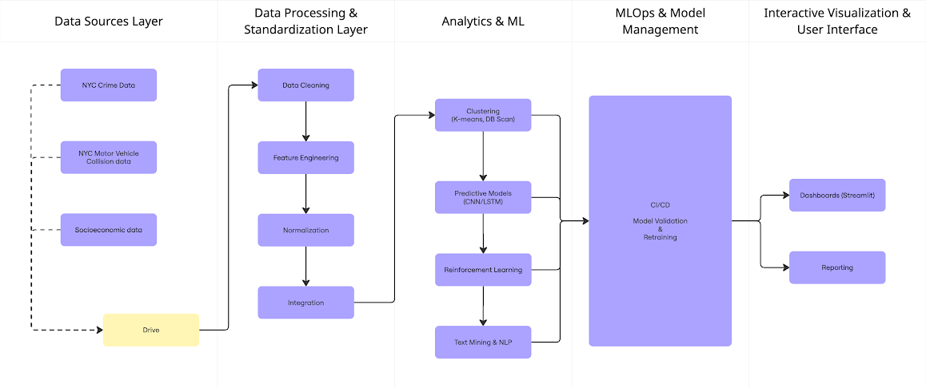
High Level Architecture

Slide 7
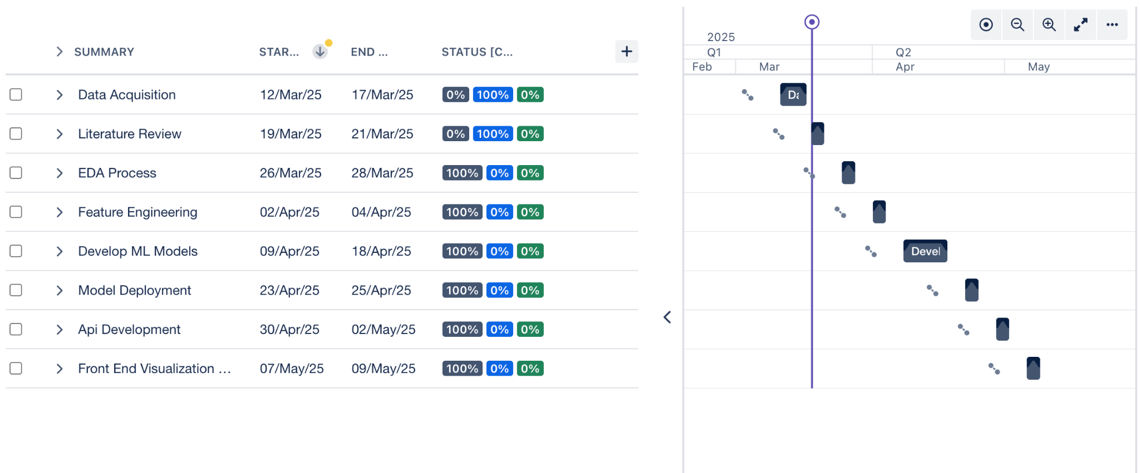
Gantt Chart

Slide 8
References:
Barton, M. S. (2014). Gentrification and violent crime in New York City. Crime & Delinquency, 62(9), 1180–1202. https://doi.org/10.1177/0011128714549652
Helland, E., & Tabarrok, A. (2004). The Fugitive: Evidence on Public versus Private Law Enforcement from Bail Jumping. The Journal of Law and Economics, 47(1), 93–122. https://doi.org/10.1086/378694
Sampson, R. J., Morenoff, J. D., & Gannon-Rowley, T. (2002). Assessing “Neighborhood Effects”: Social processes and new directions in research. Annual Review of Sociology, 28(1), 443–478. https://doi.org/10.1146/annurev.soc.28.110601.141114
White, M. D. (2012). The New York City Police Department, its Crime Control Strategies and Organizational Changes, 1970-2009. Justice Quarterly, 31(1), 74–95. https://doi.org/10.1080/07418825.2012.723032

Slide 9
References:
Hall, J. J., & Ratcliffe, J. H. (2024). Assessing the impact of safe consumption sites on neighborhood crime in New York City: A synthetic Control approach. Journal of Experimental Criminology. https://doi.org/10.1007/s11292-024-09630-z
Singh, A., Kumar, S., & Bansal, S. (2024). NYC CrimeWatch: Crime Analysis Tool. 2024 IEEE 18th International Conference on Semantic Computing (ICSC), 311–316. https://doi.org/10.1109/icsc59802.2024.00056
Paterline, B. (2012). Zimring, Franklin E. The City that Became Safe: New York’s Lessons for Urban Crime and its Control (Studies in Crime and Public Policy). International Social Science Review, 87, 180. https://www.questia.com/library/journal/1G1-327356247/zimring-franklin-e-the-city-that-became-safe-new

Slide 10
Thank you

